Slide 1
PBC COMMISSION ON ETHICS Conflicts of Interest for Advisory Board Members
Mark E. Bannon
Executive Director

Slide 2
Conflicts of Interest
The vast majority of actions that lead to violations of the PBC Code of Ethics involve two (2) factors:
The failure on the part of a person bound by the Code of Ethics to recognize a “conflict of interest” exists for them.
The actions taken by them while this “conflict of interest” exists may violate the Code of Ethics.
This why it is important for any elected official, employee, or advisory board member to identify potential “conflicts of interest” before they take an improper action.
The chart on the next slide will help you in identifying potential conflicts of interest as an advisory board member.

Slide 3
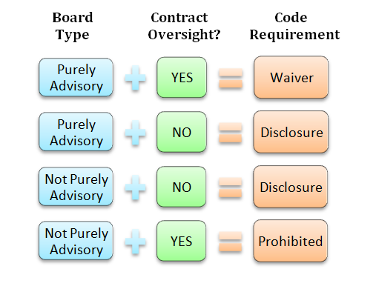
Advisory Board Conflicts

Slide 4
Purely Advisory V. Other Boards
Using the chart from the previous slide, the first issue we have to consider is the “type” of board on which you serve.
There are two general types of governmental boards to which someone can be appointed:
Boards that are “purely advisory”
Boards that are not “purely advisory”
Some governmental boards are not “purely advisory,” although they may still be referred to as advisory boards…..for example, zoning boards, and land development boards are in many cases given the power to make decisions, not just recommendations.

Slide 5
Purely Advisory V. Other Boards (cont.)
How do we determine if our board is “purely advisory?”
A “purely advisory” board is authorized only to make recommendations to some other board or individual, like the governing body, or perhaps a government administrator or hearing officer.
A board that is not purely advisory is authorized to make final decisions. A final decision does not go to any other arm of the government. These decisions can be challenged only in circuit court.

Slide 6
Purely Advisory V. Other Boards (cont.)
Some boards have both functions.
We use the term “purely” to emphasize that a board with any measure of final decision making authority is not purely advisory.
Thus, where a board has both advisory and final decision making authority (depending of the specific matter before them), they are not a “purely advisory” board under the Code of Ethics.
Your staff liaison or City Attorney should be able to answer any question you have regarding the nature of your board.

Slide 7
Contract Oversight
Moving to the next question to be considered (a question that only applies to appointed board members).
Does your board have “contract oversight” over the particular department or governmental section involving the contract?
Where you, your employer, or your business has a contract with the government that created your board, to avoid a “conflict of interest,” you must determine whether your board has anything to do with this contract in terms of oversight, regulation, management, or policy setting recommendations regarding this contract.

Slide 8
Contract Oversight (cont.)
For elected officials, this distinction does not matter…they may not enter into a contract with the public entity they serve regardless of whether they have oversight over the contract.
But for members of “purely advisory” boards, the law is different.
Where a member of such a board has contract oversight, the “conflict of interest” may be waived by the governing board of their public entity.

Slide 9
Contract Oversight (cont.)
However, where such a “conflict of interest” would be created by a member of a board that is not “purely advisory” (or a board that has land use authority), this conflict may not be waived.
Why? Because in such instances the board member has some power to both make the decision to contract with the public entity (their outside employer or business), and in their ability to oversee the subject contract once made.
This type of contract oversight is fraught with conflicting loyalties, which is why it is prohibited.

Slide 10
So…what does the Code require?
As the chart shows us there are three (3) possible outcomes.
Where your board has no authority over the contract at issue, only disclosure of the conflict created between your public entity and you, your outside employer, or your outside business is needed.
2. A waiver by the governing body is required for you (or your outside employer of business) to enter into a contract with the public entity you serve, if your board is “purely advisory,” and if you have some oversight over the subject contract.

Slide 11
So…what does the Code require? (cont.)
3. However, where your board is not “purely advisory,” and it does have “oversight” over the contract between you, your outside employer, or your outside business, disclosure is not sufficient, and there can be no waiver of this conflict, because this conflict of interest is prohibited.
If chart indicates “prohibited,” you must either decline the appointment to that board, or terminate the contract prior to the appointment.
If the possibility of a contract occurs after your appointment, you must either resign from the board, or withdraw the offer to contract with the public entity.

Slide 12
Exceptions
The same exceptions that apply to elected officials also apply to members of “advisory boards,” whether purely advisory or not.
Section 2-443(e). Prohibited Conduct, Exceptions and waiver.
The business is awarded under a system of sealed, competitive bidding to the lowest bidder and:
a. The official or employee or member of his or her household has in no way participated in the determination of the bid specifications or the determination of the lowest bidder;
b. The official or employee or member of his or her household has in no way used or attempted to use the official or employee's `influence to persuade the agency, governmental entity or any personnel thereof to enter such a contract other than by the mere submission of the bid; and
c. The official or employee, prior to or at the time of the submission of the bid, has filed a statement with the supervisor of elections and the commission on ethics, disclosing the nature of the interest in the outside employer or business submitting the bid.

Slide 13
Exceptions (cont.)
(2) An emergency purchase or contract which would otherwise violate a provision of subsection (d) must be made in order to protect the health, safety, or welfare of the citizens of the county or municipality as applicable.
(3) The outside employer or business involved is the only source of supply within the county or municipality as applicable and there is full disclosure by the official or employee of his or her interest in the outside employer or business to the county or municipality as applicable and the ethics commission prior to the purchase, rental, sale, leasing, or other business being transacted.
(4) The total amount of the contracts or transactions in the aggregate between the outside employer or business and the county or municipality as applicable does not exceed five hundred dollars ($500) per calendar year.

Slide 14
ETHICS DECISION TREE (a common sense approach to ethics training)
Is it legal?
______________________
(Does it violate state law, or a city/ county Ordinance?)
Does it comply with the Code of Ethics?
_________________________
(COE staff can assist you with this determination)
Could this create problems for your public entity or the people you serve?
________________________
(Good Government Standard)
Does it comply with city/county policy?
_________________________
(The Code may not prohibit it, but city/county policy may)

Slide 15
COE Enforcement Powers
Civil enforcement: The Commission on Ethics is a code enforcement board with quasi-judicial powers. As such, it can issue letters of reprimand or instruction, order restitution where indicated, fine an offender up to $500 per violation. Also, the public entity itself may void or rescind contracts that violate certain code provisions, and can terminate or discipline employees if they have also violated county/municipal policy.
Criminal enforcement: Knowing and willful violations of the Code of Ethics may also be punishable as first degree misdemeanors.
(can lead to punishment of up to 1 year in jail and/or a $1000 fine)

