Slide 1


The status of hiv in Palm beach county
casey Messer, dhsc, PA-C, AAHIVS
Program manager, HIV Elimination Services
July 15, 2025

Slide 2

The status of hiv in palm beach county by the numbers
Diagnoses of HIV/AIDS, 2012-2023
Number of People with HIV, 2019-2023
Number of HIV-related deaths has reached its lowest level in 5 years
HIV-Related Deaths, 2019-2023
New HIV diagnoses have returned to levels experienced prior to COVID-19
Number of people with HIV has reached its highest level in 5 years

Slide 3
The status of hiv in palm beach county
Key Accomplishments
EHE Healthcare + Housing Opportunities (H2O)
Launched on June 17th; Chronic Disease Management Self-Sufficiency Program
Goal: Increased access and adherence to comprehensive health care in coordination with stable, permanent housing for persons with HIV who are severely cost-burdened or experiencing homelessness
39 clients enrolled; 10 pending enrollments; 2 successful outplacements
74% have become employed; 15% enrolled in vocational training
51% have become virally suppressed; 56% have become permanently housed
H2O Services Include:
H2O Case Management Transitional housing Tele-Adherence Counseling
Transportation assistance Relocation assistance Employment counseling
Budget-deficit rent/utility assistance Vocational rehabilitation/GED/ESL

Slide 4
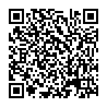
The status of hiv in palm beach county
Key Accomplishments
Free At-Home HIV Self-Test Kits
Provides PBC residents the ability to request free HIV self-test kits mailed to their home at Know Your HIV Status
Direct-to-client email to registered OSCARSS users sent June 27th (National HIV Testing Day) and Repeated on December 1st (World AIDS Day)
578 tests have been mailed

Slide 5
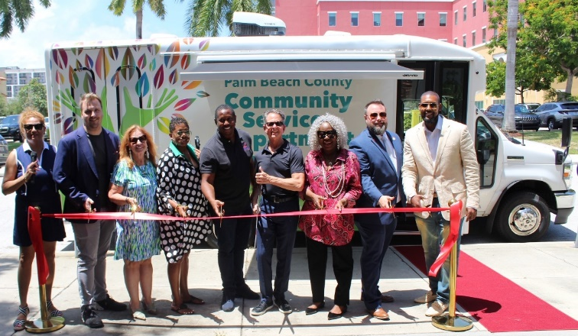
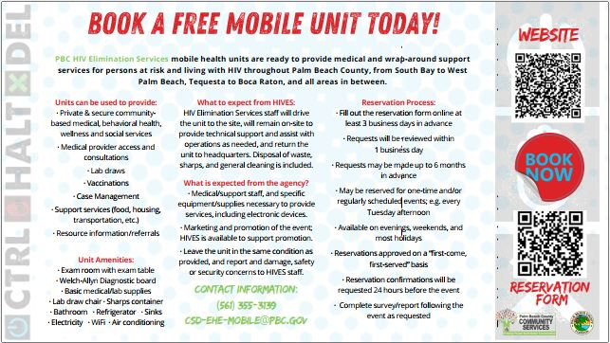

The status of hiv in palm beach county
Key Accomplishments
CSD Mobile Units
Ribbon-cutting held on July 19th
35 service events scheduled in first 6 months (GY24)
  15 service events in western communities (Belle Glade, Pahokee)
HIV Elimination Services Mobile Unit Webpage

Slide 6

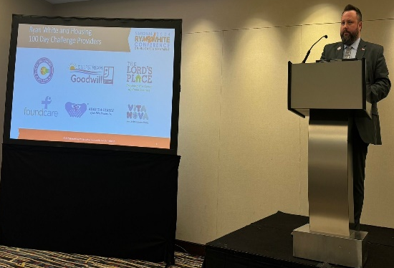
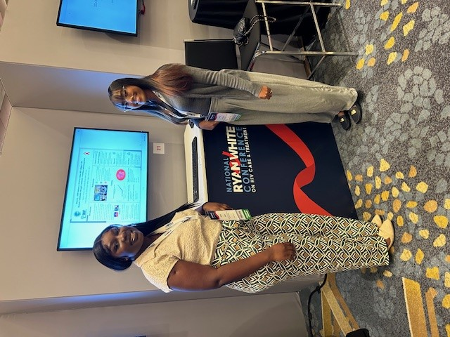
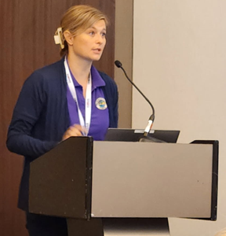
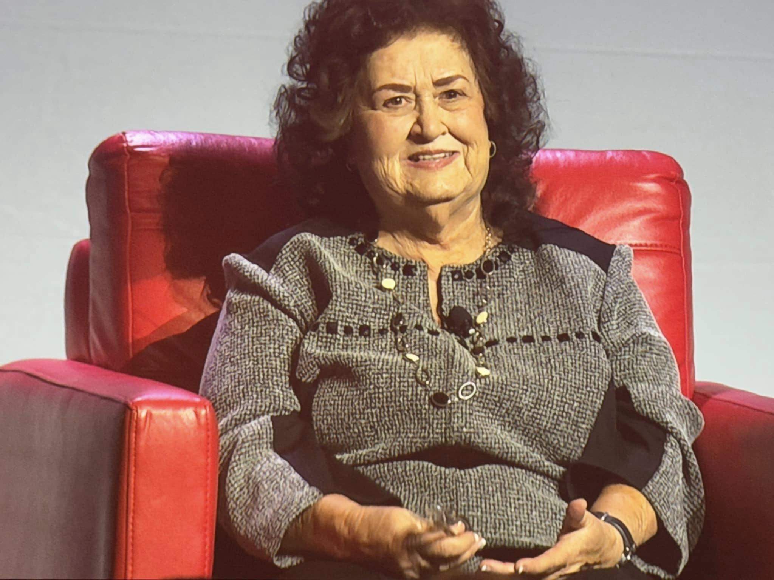
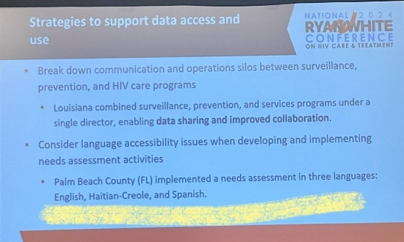
The status of hiv in palm beach county
Key Accomplishments
National Ryan White Conference on HIV Care & Treatment
Washington, D.C. August 20-23rd
PBC HIVES Staff presented 8 oral sessions and posters; 2 Plenary spotlights

Slide 7
The status of hiv in palm beach county
Key Accomplishments
Health Insurance Premium & Cost-Sharing Assistance
Viral suppression rates for PWH with comprehensive health insurance is 10% higher compared to uninsured
Private Insurance is now the largest insurance status for PWH in PBC
$2,370,643 in grant funding generated $8,535,125 in program income (revenue); ROI=260%

Slide 8
The status of hiv in palm beach county
Key Accomplishments
Data to Care Initiative (D2C)
Data to Care (D2C) uses mandated HIV lab reporting data to proactively identify PWH who are not in care and facilitate their re-engagement
PBC was first in FL to pilot D2C with EHE Community Outreach, Response, and Engagement (CORE) Teams through Data Sharing Agreement with FDOH
204 out-of-care client cases received; 169 client cases (82.8%) have been worked

Slide 9
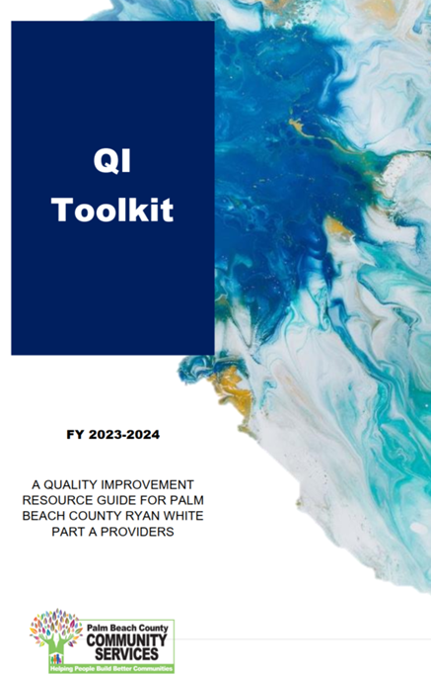
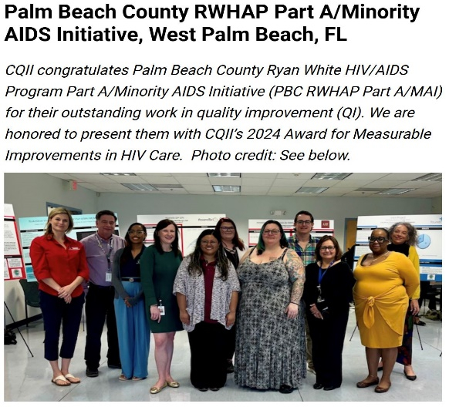

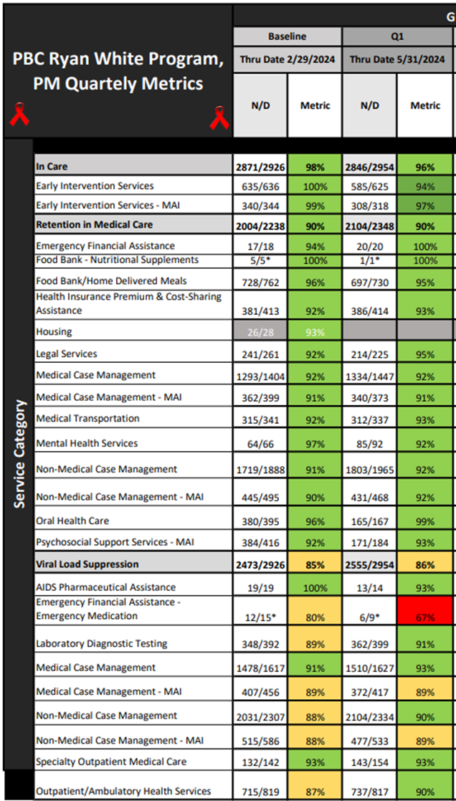
The status of hiv in palm beach county
Key Accomplishments
Continuous Quality Management (CQM)
National Center for Quality Improvement & Innovation (CQII) 2024 Award for Measurable Improvements in HIV Care
  “Identifying Disparities to Engage Action (IDEA)” QI project to reduce disparities in viral suppression (VS) rates among racial/ethnic minority groups

Slide 10






The status of hiv in palm beach county
Key Accomplishments
Ctrl Halt Del Strategic Marketing Campaign
Launched on December 16th; Control Risks, Halt the Spread, Delete Stigma
Empowering individuals to take charge of their health by being proactive in reducing risks of HIV
Stopping the spread of HIV through care, treatment, and harm-reduction
Erasing HIV stigma and disparities in health outcomes
HIV Antiretroviral Treatment
U=U
Behavioral Health/ Substance Use Disorders
Syringe Services Program
Social Determinants of Health
HIV stigma
Inequities among racial/ethnic minorities
HIV Testing
HIV Counseling & Education
Safer Sex Practices
HIV PrEP/PEP

Slide 11
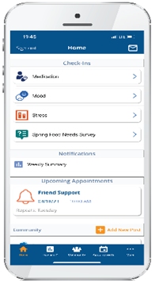
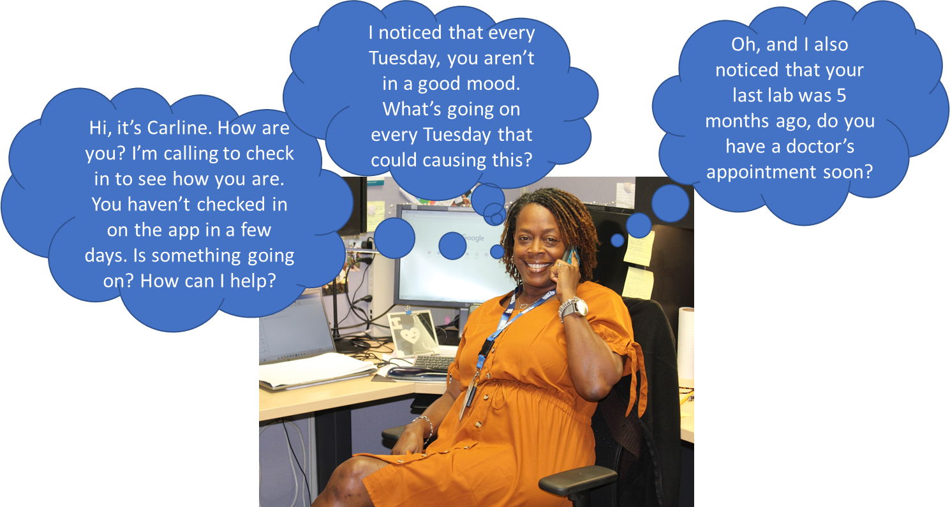
The status of hiv in palm beach county
Key Accomplishments
Tele-Adherence Counseling (TAC)
A mobile health (mHealth) tele-service providing daily medication reminders, lab results, medication adherence/mood/stress check-ins, community message board, community resources, and direct contact with a telehealth counselor
Clients who do not have a smartphone are provided one; Monthly data plan provided for clients who achieve a 71% participation rate of daily check-ins
TAC program participants (N=110) demonstrated an improvement in viral suppression from 0% at enrollment to 86% within 12 months.
National Association of Counties (NACo) Award 2024
PBC Golden Palm Award 2024

Slide 12
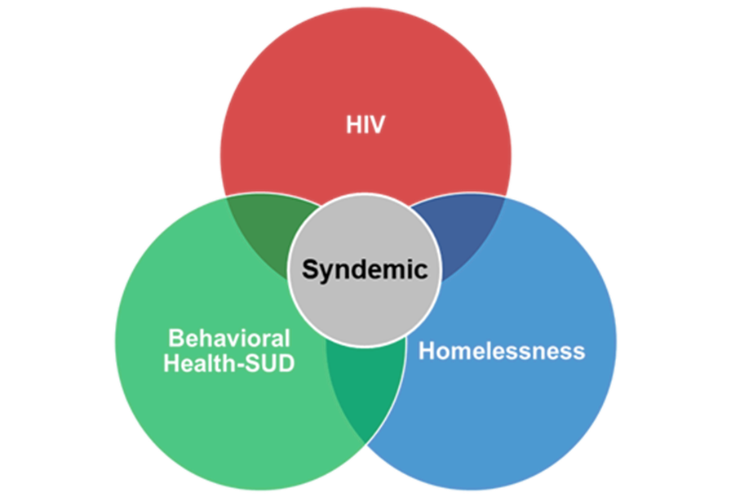
The status of hiv in palm beach county
Looking forward to gy25
Operationalizing Syndemic Services
  Recovery Community Hubs, HRCs, Senior Centers, etc.
Tele-Adherence Counseling Research with UF
340B Program Implementation
Jail/Justice-Involved Linkage Initiative with PBSO
Countywide HIV Needs Assessment (3 year)
Integrated HIV Prevention & Care Plan Update (5 year)
Syringe Services Program 5-year Anniversary

Slide 13

Questions?
For HIV Services in Palm Beach County,
1-833-PBC-HIV1 (1-833-722-4481)
Control Risks. Halt the Spread. Delete Stigma
#ENDHIVPBC

