Slide 1
L.I.T. (Liberating, Inspirational, and Transformative) 2.0
Summer 2022
Grades K - 5
The Office of African, African American, Latino, Holocaust and Gender Studies.
Brian Knowles, Manager
K- 12 Physical Education
Eileen Tirado, Resource Teacher
K-12 Arts Education
Cleve Maloon, Program Planner
Monica Bailow, Resource Teacher

Slide 2
Outline
L.I.T. (Liberating, Inspirational, and Transformative) - Curriculum designed to be engaging, educational, culturally responsive and developmentally appropriate for K - 5 students.
Learning Units:
Week 1 - All About Me - Students will share facts about themselves, which includes their culture, traditions, and community.
Week 2 - Exploring the Worlds of Marvel and DC - Instructors will help students cultivate essential skills by exploring the dynamic characters from and the histories of the Marvel and DC universes.
Week 3 - Real Life Heroes and Sheroes - Students will have the opportunity to learn about individuals from our history that exhibited extraordinary abilities, courage or sacrifice.
Week 4 - S.T.E.M. World’s Greatest Inventors, Scientists, and Mathematicians - Students will learn about some of history's greatest technological advancements and the people behind these innovations.
Week 5 - Exploring the World of Sports - Students will explore a variety of sports and learn about athletes that excelled at their respective sport and made positive contributions to the world.
Week 6 - Exploring the World of Art: Music, Visual Art, and Dance - Students will engage in an interactive learning experience through the dynamic worlds of music, visual arts and dance. They will explore
the histories of various artforms and some of the most talented artists from the modern era.
Week 7 - Cash Rules Everything Around Me: Economics and Financial Literacy - Students will learn the basics about money and understand the significance of financial responsibility.
Week 8 - The People Who Made the World A Better Place - Instructors will help students cultivate a sense of social responsibility by investigating the lives of some of greatest leaders in history.
Week 9 - Exploring My Community - Students will gain a sense of pride about the local community as they learn about the history, government, and geography of Palm Beach County.
Learning pursuits:
Identity - Teaching students to know themselves and others;
Skills - teaching students the proficiencies needed across content areas;
Intellectualism – teaching students new knowledge;
Criticality – teaching students to understand and disrupt injustice; and
Joy – teaching students about the beauty and truth in humanity.

Slide 3
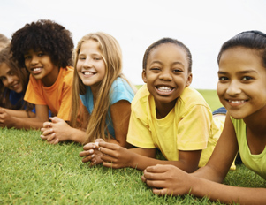
Week 1 - All About Me
Learning Pursuits
Identity - Students will learn about the different aspects of their cultural identity.
Skills - Students will analyze their own traditions and social norms.
Intellectualism - Students will learn about the concept of diversity.
Criticality - Students will appreciate the beauty within themselves and those who are different.
Joy - Students will celebrate their own individual and collective uniqueness
Resources
Activities Grades K - 2 What is Culture? Learning About Family Traditions Kids Share Their Cultural Tradition | Show & Tell Understanding My Family's History Sankofa Read Aloud Mr. Alicea's Arcade of Knowledge One Classroom, Many Cultures Holidays Around the World Worksheets Grades 3 - 5 What is Culture? Learning About Family Traditions Understanding My Family's History My Life, My World Culture, What You See and What You Don't
Instructor’s Resources | Sharing Many Cultures in the Elementary Classroom Exploring Cultures in Your Classroom: Fun Activities to Try
Arts & Physical Education
The Arts Brain Break
Get Up and Move! Pick a BRAIN BREAK! Let’s have Fun being Active!

Slide 4
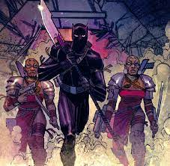
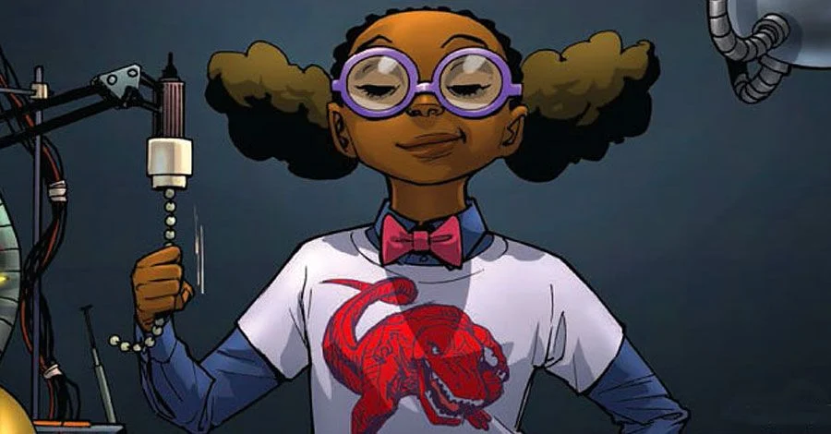
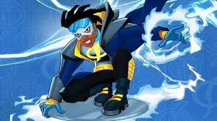
Week 2 - Exploring the Worlds of Marvel and DC
Learning Pursuits
Identity - Students will learn about a variety of character identities represented in comic books.
Skills - Students will learn sounds, syllables, spelling and cultivate their ability to write.
Intellectualism - Students will learn about heroism
Criticality - Students will learn about the need to combat injustice.
Joy - Students will explore their creativity and imagination and how it can be used to bring joy to others.
Resources
Grades K - 2 Resources: KIndergarten (Phonemic and Phonological Awareness - Sounds and Syllables) Grades 1 - 2 (Spelling and Writing) Activities: A-Z Comic Book Characters Comic Book Activity Kit BAM! POW! Comic Strip Writing Top 10 Superheroes Grades 3 - 5 Resources: Marvel Comics facts for kids DC Comics facts for kids How Jewish Writers Shaped The Comic Book Superhero Stan Lee facts for kids Jack Kirby facts for kids 1) Dahomey Amazon Women Warriors 2) Dora Milaje 1) Virgil Hawkins/Static (Contains Sensitive Content Grade 5 Guided Only) 2) Static 1) Norse mythology facts for kids 2) Thor facts for kids 5 Latino Superheroes Top 10 Superheroes With Disabilities You Need To Know About Activities: The World of DC and Marvel
Instructor’s Resources | Teacher Guide to Comic Books in the Classroom A Guide to Using Graphic Novels With Children and Teens
Arts & Physical Education | The Arts Brain Break Get Up and Move! Pick a BRAIN BREAK! Let’s have Fun being Active!

Slide 5
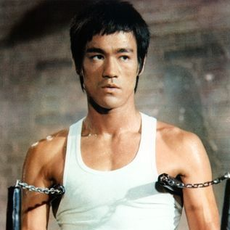
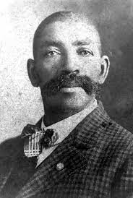
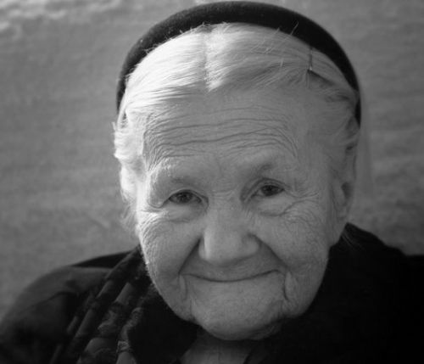
Week 3 - Real-Life Heroes and Sheroes
Learning Pursuits
Identity - Students will see themselves as extraordinary and consider using their abilities to help others.
Skills - Students will compare and contrast different forms of heroism.
Intellectualism - Students will learn the concept and meaning of heroism.
Criticality - Students will understand the importance of using your gifts and talents to help others.
Joy - Students will understand the joy of being a positive contributor to society.
Resources
Grades K - 2 Resources: A Hero Like You | A story about everyday heroes How To Be A Hero Activities: Heroes in Our Community Superhero Citizens Mini-Lesson: What Is a Hero? What Makes A Hero? Everyday Heroes Worksheet Grades 3 - 5 Resources: 1) Bass Reeves - BrainPOP 2) Bass Reeves facts for kids 1) Bruce Lee Biography 2) Bruce Lee facts for kids 1) How one person saved over 2,000 children from the Nazis (Contains Sensitive Content Grade 5 Guided Only) 2) The Holocaust facts for kids (Contains Sensitive Content Grade 5 Guided Only) 3) Irena Sendler facts for kids Queen Amanirenas: The Story of the White Nile Nubi Archeress 1) Juana Azurduy – The Female Guerilla Fighter 2) Juana Azurduy: Heroine of Independence 1) Toussaint Louverture facts for kids 2) Same Time, Different Place Toussaint Louverture (Contains Sensitive Content Grade 5 Guided Only) Activities: What Makes a Hero? Read and Say Something and Personal Reflection
Instructor’s Resources | Everyday Heroes Talking About Our Heroes Teacher Tips from A to Z
Arts & Physical Education | The Arts Brain Break Get Up and Move! Pick a BRAIN BREAK! Let’s have Fun being Active!

Slide 6
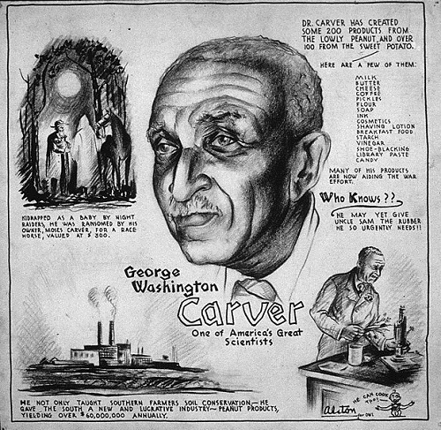
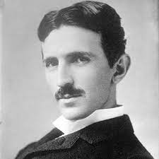
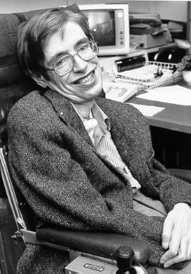
Week 4 - S.T.E.M - The World’s Greatest Inventors, Scientists, and Mathematicians
Learning Pursuits
Identity - Students can see themselves as future Inventors, Scientists, and Mathematicians
Skills - Students will identify cause and effect by examining advances in technology.
Intellectualism - Students will learn about individuals that have made valuable contributions to science and technology.
Criticality - Students will see that the development of society depends on the creativity and innovation of various groups of people.
Joy - Students can see how technology can make the world a better place.
Resources
Grades K - 2 Resources: The First Ever Pyramid For Kids Amazing Inventions by Black People | Kids Black History The ABCs of Black Inventors Who is Benjamin Banneker? Top 10 Fun Facts for Students Steve Jobs | Stories for Kids Nikola Tesla Children's introduction to Albert Einstein Camera Obscura: Muslim Invention | Muslim Heroes & Inventors 10 Great Inventions by Women Hidden Figures by Margot Lee Shetterly and Laura Freeman Story Time Read Aloud Activities: Create Your Own Invention Researching Female Inventors Researching Black Inventors Grades 3 - 5 Resources: Time Kids - Inventions Stephen Hawking facts for kids NASA’s Hispanic Astronauts NASA's African American Astronauts 1) Nikola Tesla 2) Nikola Tesla facts for kids 1) Who is ELON MUSK? 2) Elon Musk facts for kids Asian Inventors Native American Inventions Introducing Lewis Latimer 5 Mayan Inventions That Will Surprise You Activities: Create Your Own Invention Research The Peanut Man Lewis Latimer Granville Woods
Instructor’s Resources | Creativity & Creative Thinking
Arts & Physical Education | The Arts Brain Break Get Up and Move! Pick a BRAIN BREAK! Let’s have Fun being Active!

Slide 7
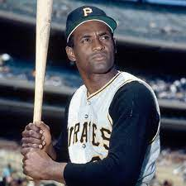
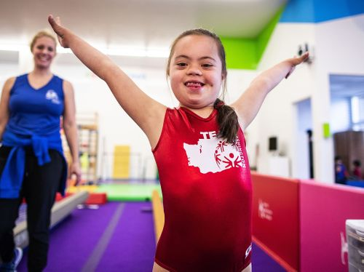
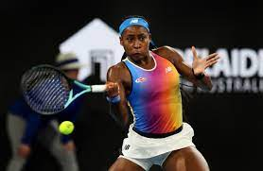
Week 5 - Exploring the World of Sports
Learning Pursuits
Identity - Students will connect with professional athletes that share similar backgrounds.
Skills -Students will learn sounds, syllables, spelling and cultivate their ability to write.
Intellectualism - Students will research the history, evolution, and impact of North American sports.
Criticality - Students will examine the barriers that some athletes had to overcome to play sports and how they used their experiences to remove barriers for others.
Joy - Students will explain what sports and athletes are their favorites.
Resources
Grades K - 2 Resources: KIndergarten (Phonemic and Phonological Awareness - Sounds and Syllables) Grades 1 - 2 (Spelling and Writing) Sports Song | Do You Like Sports? Who invented basketball? Baseball Facts - All About the Game of Baseball I am Jackie Robinson | Children's Books Read Aloud How To Draw Jackie Robinson Play Ball: Roberto Clemente's Legacy Nickelodeon's Guide to Football! Little People, Big Dreams: Muhammad Ali | READ ALONG with Hana Ali | PBS KIDS Sport for people with disabilities Grades 3 - 5 Resources: 1) Old Man & The Bully: A Capoeira Story (Grade 3 - Sensitive Content) 2) Capoeira facts for kids The History of Professional Football in America Equality, sports, and Title IX 5 Incredible Female Athletes Coco Gauff Facts for Kids Lusia Harris: The First Woman Ever Drafted by an NBA Team 1) Disabled People Who Play Professional Sports 2) Special Olympics facts for kids Anquan Boldin facts for kids Black Fives Basketball: Hidden Hardcourt Heroes 1) Negro Leagues 2) The Negro League Baseball: Shattering Segregation 1) Jim Thorpe facts for kids 2) Jim Thorpe - the Best Athlete you've never heard of 1) Muhammad Ali facts for kids 2) Muhammad Ali Biography (History for Kids) 1) Roberto Clemente facts for kids 2) Roberto Clemente: A True Baseball Hero Activities: Read and Say Something What a Pro Knows: Playing to Win Exploring the World of Sports
Arts & Physical Education | The Arts Brain Break Get Up and Move! Pick a BRAIN BREAK! Let’s have Fun being Active

Slide 8
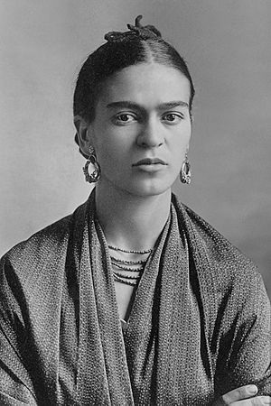
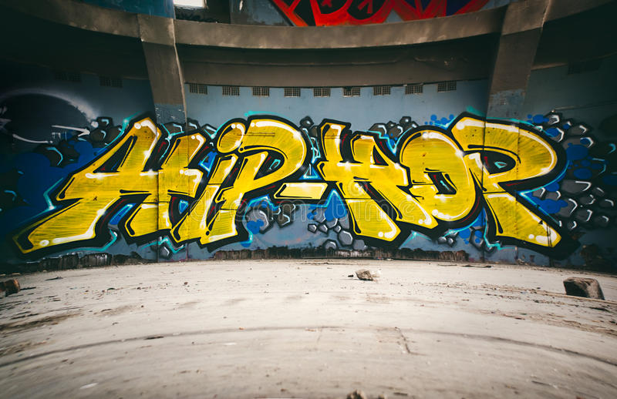
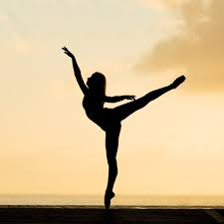
Week 6 - Exploring the World of Art: Music, Visual Art, and Dance
Learning Pursuits
Identity - Students will identify with artistic expressions that resonates with their own cultural identities.
Skills - Students will identify and analyze different forms of expression.
Intellectualism - Students will investigate the history of specific types of art and the artists behind them.
Criticality - Students will see how art can be used to provide voice and as a weapon to fight injustice.
Joy - Students will express themselves through their own talents and gifts.
Resources
Grades K - 2 A Musical Journey What is Jazz Music? The Story of Rap | Read Aloud | Rap for Kids Welcome to Jazz by Carolyn Sloan (Read -Aloud) How Music Can Make Us Feel Different Ways | Tab Time Alvin Ailey READ ALONG with MISTY COPELAND! | Bunheads | PBS KIDS African Dance Field Trip Anansi and the Hat Shaking Dance I Am Frida Kahlo "Radiant Child: Story of Young Artist Jean-Michel Basquiat" by Javaka Steptoe | PBS Books Storytime Activities: FY22 Gr. K-2 Drawing South African Ndebele Houses 5 Frida Kahlo Art Project & Lesson Ideas for Kids for your Classroom Jazz Up Writing Workshop: Writing Biographies of African American Jazz Musicians (Grade 2) ISLAMIC ART LESSON FOR KIDS: A LOOK AT ARABIC TILES Contour Portrait Lesson Plan Grades 3 - 5 Resources: 1) The History of Jazz 2) Jazz facts for kids 1) The Birth of Hip Hop 2) Hip Hop Facts for Kids 3) A Latino History of Hip-Hop 1) Latin Music Facts for Kids 2) Selena facts for kids 3) Who is Selena Quintanilla-Pérez? 1) Reggae facts for kids 2) Bob Marley facts for kids 3) Bob Marley Legendary Reggae Singer-Songwriter | Mini Bio | BIO 1) Stevie Wonder facts for kids 2) Who is Stevie Wonder? (Biography) 1) Frida Kahlo facts for kids 2) Frida Kahlo: A Brief History Who Was Basquiat? Activities: Read and Say Something Marian's Revolution Dancing Towards Dreams The Kanneh-Masons: The family that plays together Kids Meet an Opera Singer Whitacre Seal Lullaby: Performed by the Kanneh-Mason family Esperanza Spalding performing "On The Sunny Side Of The Street" Huang Yuxing Bubble Designs
Instructor’s Resources | 6 Famous Artists for Kids to Study + Classroom Art Activities
Physical Education | The Arts Brain Break Get Up and Move! Pick a BRAIN BREAK! Let’s have Fun being Active

Slide 9
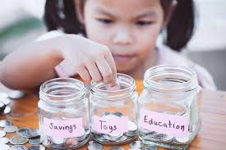
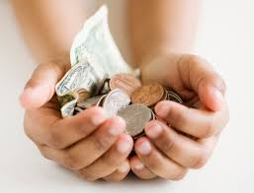
Week 7 - Cash Rules Everything Around Me: Economics and Financial Literacy
Learning Pursuits
Identity - Students will understand the value of money and financial responsibility in their lives and communities.
Skills - Students will develop an understanding of money, budgeting, saving, supply and demand.
Intellectualism - Students will investigate economic principles.
Criticality - Students will consider the relationship between money and power/control
Joy - Students will list ways that financial literacy can improve life for themselves and their families and communities.
Resources
Grades K - 2 Resources: Learn about Money for Kids (USA Money and Currency) SNL’s Kate McKinnon and Beth Kobliner talk money with kids. Fun with financial literacy! Do You Know How to Save? | Ubongo Kids Learn Financial Literacy How to save money as a kid! Watch our Leadership Series: Money saving for kids Counting Coins Song for Kids | Penny, Nickel, Dime, Quarter | 2nd Grade Activities: My Classroom Economy Financial Literacy for Kids Grades 3 - 5 Resources: 5 Minute Lesson for Kids Money BrainPOP 5 Minute Lesson for Kids Budgets BrainPOP 5 Minute Lesson for Kids Comparing Prices BrainPOP 5 Minute Lesson for kids Needs and Wants BrainPOP 5 Minute Lesson for Kids Banking BrainPOP 5 Minute Lesson for kids Interest BrainPOP 5 Minute Lesson for kids Credit Cards BrainPOP 5 Minute Lesson for kids Debt BrainPOP 5 Minute Lesson for kids Stock Market BrainPOP Activities: My Classroom Economy Financial Literacy for Kids
Instructor’s Resources | Smart Path Financial Literacy Rocks
Arts & Physical Education | The Arts Brain Break Get Up and Move! Pick a BRAIN BREAK! Let’s have Fun being Active

Slide 10
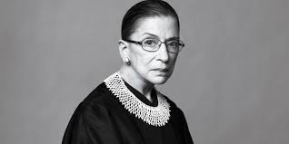
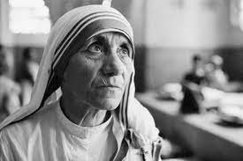
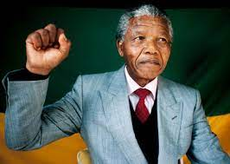
Week 8 - The People Who Made the World A Better Place
Learning Pursuits
Identity - Students will see themselves as advocates for change.
Skills - Students will compare and contrast various methods of activism.
Intellectualism - Students will understand the concept of activism.
Criticality - Students will understand the significance of combating injustice and elevating the voices of the marginalized.
Joy - Students will see how persistence brings to joy to the world.
Resources
Grades K - 2 Resources: She Persisted: 13 American Women Who Changed the World The Legacy of Dr. Martin Luther King Jr. | BrainPOP I Am Martin Luther King Jr by Brad Meltzer| Books Read Aloud Who Was Ruth Bader Ginsburg? Read Aloud with Author Lisbeth Kaiser Helen Keller for Kids Mother Teresa (Biography for Children) Nelson Mandela Read Aloud Cesar Chavez Read Aloud Activities: Ordinary People Change the World Classroom Resources for Martin Luther King, Jr. World Changers Grades 3 - 5 Resources: How Kids Changed the World 1) Ruth Bader Ginsburg - Supreme Court Judge 2) Ruth Bader Ginsburg facts for kids 1) Nelson Mandela Facts! 2) Nelson Mandela facts for kids 1) Mahatma Gandhi facts for kids 2 Mahatma Gandhi | Short Story for Kids 1) Mother Teresa - 20th Century Humanitarian | Biography 2) Mother Teresa facts for kids 1) Martin Luther King Jr. facts for kids 2) Dr.Martin Luther King Jr for Kids! 1) Helen Keller (Biography for Children 2) Helen Keller facts for kids 1) César Chávez facts for kids 2) CESAR CHAVEZ! - Mini Fantastic Facts Activities: Read and Say Something Classroom Resources for Martin Luther King, Jr. SÍ SE PUEDE! The Legacy of Cesar E. Chavez World Changers People Who Have Changed the World Project
Instructor’s Resources | Children Changing the World
Arts & Physical Education | The Arts Brain Break Get Up and Move! Pick a BRAIN BREAK! Let’s have Fun being Active

Slide 11
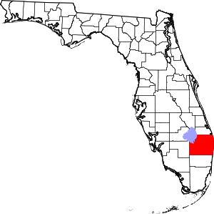
Week 9 - Exploring My Community
Learning Pursuits
Identity - Students will see themselves as experts about the history,geography, and government of their communities.
Skills - Students will investigate the history of Palm Beach County by evaluating sources to develop an informed interpretation.
Intellectualism - Students will develop an understanding of the historical and geographical development of Palm Beach County.
Criticality - Students will see how their communities came into existence through the persistence, sacrifice, and contributions of diverse groups.
Joy - Students will gain a sense of pride by seeing themselves as positive contributors to their communities
Resources
Grades K - 2 Resources: Florida for Kids | US States Learning Video Black Heritage Trail Palm Beach County Flagler Museum Virtual Tour Activities: 1) Printable Maps Florida Counties (Blank) 2) Printable Maps Florida Counties (With Names) 1) Little Red Schoolhouse 2) Teacher's Manual Grades 3 - 5 Resources: Origins, Palm Beach County West Palm Beach, Florida facts for kids Overview of County Government Flagler Museum Virtual Tour Native Americans in Palm Beach County Flagler Era (Students will read the following) Build it and they will come Hotel Life The Styx The Other Side of Lake Worth Goods and Services Teaching and Preaching Getting Around Fun and Games become Culture Beyond the Palm Beaches Black Voices from Palm Beach County History George Sukeji Morikami Black Heritage Trail Palm Beach County Activities: 1) Printable Maps Florida Counties (Blank) 2) Printable Maps Florida Counties (With Names) Read and Say Something Heritage Education Pioneer Era Lesson Plans
Instructor’s Resources | Historical Society of Palm Beach County: Teaching Resources Spady Museum Morikami Museum Boca Raton Historical Society Jupiter Inlet Lighthouse
Arts & Physical Education | The Arts Brain Break Get Up and Move! Pick a BRAIN BREAK! Let’s have Fun being Active

