Slide 1
Procedural Justice, Implicit Bias, and Body Worn Cameras
Cassandra A. Atkin-Plunk, PhD
Vaughn J. Crichlow, PhD
Florida Atlantic University

Slide 2
Overview
Procedural justice
Implicit bias
Body worn cameras

Slide 3
Procedural justice

Slide 4
Focus of Procedural Justice
Contact
Process
Outcome

Slide 5
Focus of Procedural Justice
Contact
Fairness of Process
Outcome

Slide 6
Elements of Procedural Justice
Procedural Justice
Voice
Neutrality
Helpfulness
Understanding
Respect

Slide 7
What is procedural justice?
“Idea of fairness in the process that resolves disputes and allocates resources” – U.S. Department of Justice
Evidence-based, cost-effective way to reduce crime

Slide 8
Importance of Procedural Justice
Procedurally just treatment
Increased legitimacy
Cooperation with legal authorities
Compliance with directives
Increased satisfaction with CJ authorities
Compliance with the law
Increased trust and confidence in system

Slide 9
Strategies for Enhancing Procedural Justice
Humanize the experience
Explain what you’re doing and why
Create opportunities for individuals to be heard
Consider environmental factors

Slide 10
Procedural Justice in Policing
Stockton (CA) Police Department
Created comprehensive training tailored specifically for Stockton PD
Adding PJ training to SPD’s Training Academy
Adding tenants of PJ to policies

Slide 11
Procedural Justice in the Courts
Milwaukee (WI) County Criminal Court
Worked to improve oral, written, and nonverbal communication used by judges
Identified concrete steps to implement PJ in the courtroom
Making eye contact, explaining purpose for court appearance, explaining legal terms

Slide 12
Procedural Justice in Corrections
Florida Department of Corrections (FDC)
Everglades Reentry Center
Inmates are called “Residents”
All categories of staff are trained in MI

Slide 13
Organizational Culture and Procedural Justice
Core principles of PJ should be valued within entire agency
Organizational culture matters
Does not happen overnight

Slide 14
Internal Procedural Justice
Supervisors
Line Level Staff
Organizational Commitment
Job Stress/ Satisfaction
Citizens
Staff Well-Being

Slide 15
Implicit bias

Slide 16
The Origins of Implicit Bias
The concept of implicit bias developed in the field of social psychology
We all use stereotypes often without knowing it
Human behavior can therefore be explained by both conscious and unconscious mental processes
Notes:
Implicit bias can be traced to the work of Sigmund Freud
It was once believed that only bigoted people used stereotypes. However, the study of unconscious bias shows that we all use stereotypes often without knowing it.

Slide 17
What is implicit bias?
The automatic associations individuals make between groups of people and stereotypes about those groups
The associations reside deep in the subconscious
Implicit bias should not be confused with conscious biases that people tend to conceal
Notes:
Automatic associations are activated involuntarily and reside deep in the subconscious.
Automatic associations also do not necessarily line up with consciously declared beliefs.
Implicit biases should not be confused with conscious biases that people tend to conceal in order to be politically correct, to avoid censure or condemnation.

Slide 18
Where does implicit bias come from?
From early childhood, through direct and indirect messages about people based on race, ethnicity, age, gender and appearance
Biases also develop over one’s lifetime
News and entertainment media have a strong influence

Slide 19
Why is it important to recognize implicit biases?
Automatic associations can influence behavior
Implicit bias makes people respond in certain ways that could lead to anger and distrust

Slide 20
Implicit Association Tests (IATs)
Measures attitudes and beliefs that people may be unwilling or unable to report
Tool used to detect strength of associations between concepts (e.g., black people, gay people) and evaluations (e.g., good, bad) or stereotypes (e.g., athletic, clumsy)

Slide 21
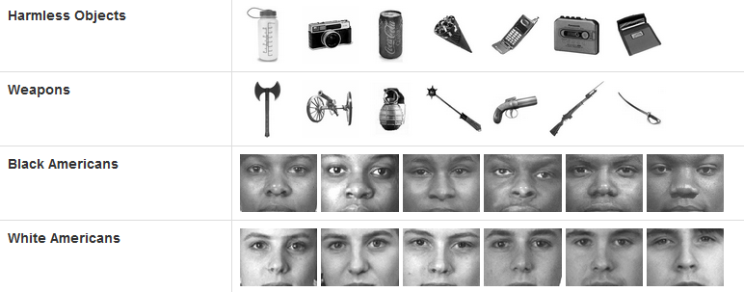
Weapons Implicit Association Test (IAT)

Slide 22
Sexuality IAT

Slide 23
Gender-Career IAT

Slide 24
Implicit Association Test Demonstration

Slide 25
Benefits of Acknowledging Implicit Biases
IATs effectively predict a range of behaviors
Concern is that practitioners will act on biases
Awareness of biases is important

Slide 26
How to Become Aware of Biases
Take an implicit association test (IAT)
https://implicit.harvard.edu/implicit/selectatest.html

Slide 27
How to Reduce Implicit Biases
Consciously acknowledge individual and group differences (don’t ignore them)
Check through decisions for possible bias
Increase exposure to stereotyped group members
Diversity education

Slide 28
Body Worn Cameras

Slide 29
How BWCs came to pass
Increased scrutiny of officer behavior and police-community relations
Presidential Task Force on 21st Policing launched –62 policing recommendations
BWCs will help to achieve Task Force goals
Proposed investment of $75 million to purchase 50,000 BWCs for police throughout the US

Slide 30
Impact of Ferguson, Baltimore on use of BWCs
Led to a national discussion on police-community relations
Interim Report of Task Force released one month after the grand jury decided not to indict police officer in Michael Brown case

Slide 31
Ways BWCs can be useful
Reduce frivolous complaints
More accountability for police and transparency
Improve police officer conduct and citizen behavior
Increase officer and citizen safety
Increase public confidence in police
Decrease police use of force incidents
Assist in criminal prosecutions
Facilitate officer training
Notes:
Miller, L., Toliver, J., & Police Executive Research Forum. (2014). Implementing a body-worn camera program: Recommendations and lessons learned. Washington, DC: Office of Community Oriented Policing Services.
Smykla, J. O, Crow, M. S. Crichlow, V. J. & Snyder, J. A (2016). Police Body-Worn Cameras: Perceptions of Law Enforcement Leadership. American Journal of Criminal Justice 41(3): 424-443. Online First: December 4, 2015.
Crow, M. S., Snyder, J. A., Crichlow, V. J. & Smykla, J .O. Forthcoming. “Community Perceptions of Police Body-Worn Cameras: The Impact of Views on Fairness, Fear, Performance, and Privacy.” Criminal Justice and Behavior

Slide 32
Concerns about BWC use
Impact on police discretion
Endangering lives of police
Unfair intrusion into police conduct
Management of information coming from BWC
Potentially resource intensive
Questions involving freedom of information

Slide 33
Policy questions to consider prior to implementation
What privacy policies need to be in place before officers begin using BWCs?
How will the BWC program impact prosecutorial and defense resources?
How quickly should BWC footage be released after an incident?
What cybersecurity plans are needed for digital evidence storage?
Should the agency’s BWC policy be publicly accessible?
Notes:
Cotter, Heather R. (2017). 5 body-worn camera policy issues you need to address before procurement: From privacy to cybersecurity, law enforcement agencies must have their plans in place. Contemporary Issues in Policing. Retrieved from https://www.policeone.com/police-products/body-cameras/articles/294231006-5-body-worn-camera-policy-issues-you-need-to-address-before-procurement/

Slide 34
BWC use in FL
Most police departments in Florida plan to use body cameras
18% of police agencies in Florida have fully implemented BWCs
The case of WPBPD
Are agencies getting what they pay for? (Better/more than dashcam?)

Slide 35
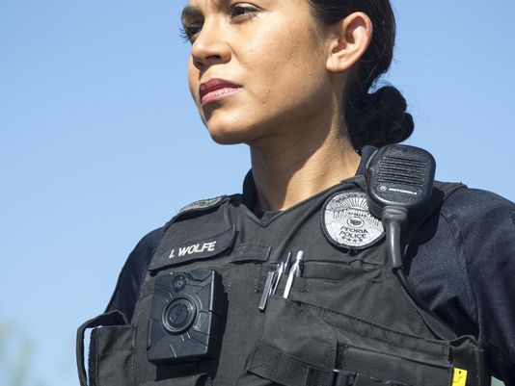
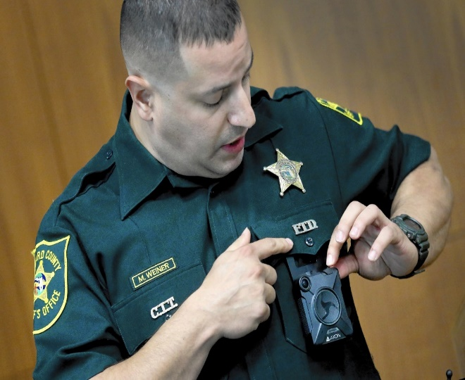
BWC research
Relatively new/growing area
3 years’ worth of studies
Most research focuses on police and community perceptions of BWCs… Fewer studies on the impact of BWCs on policing and crime indicators

Slide 36
Impact of BWC on policing, courts, corrections
Findings from Rialto, CA – (1) Some evidence of reductions in use-of-force incidents, (2) Citizen complaints against the police were significantly reduced
Concerns about open-records laws in many jurisdictions highlight the need for policies on public release of videos from BWCs
Is legal reform needed?
Notes:
Ariel, B., Sutherland, A., Henstock, D., Young, J., Drover, P., Sykes, J., Megicks, S., & Henderson, R. (2016). Report: Increases in police use of force in the presence of body-worn cameras are driven by officer discretion: A protocol-based subgroup analysis of ten randomized experiments. Journal of Experimental Criminology, 12, 453-463.
The findings of this study show evidence of reductions in use-of-force incidents for Rialto Police Department.

Slide 37
The Big Picture
Together we can achieve a CJ system in which justice is not only done but appears to be done by:
Sustaining partnerships (Practitioners-Researchers-Community)
Sharing knowledge openly and using evidence to inform CJ practice

Slide 38
Cassandra A. Atkin-Plunk, PhD
catkinplunk@fau.edu
561-297-3928
Vaughn J. Crichlow, PhD
vcrichlow@fau.edu
561-297-4171

